Slide 1
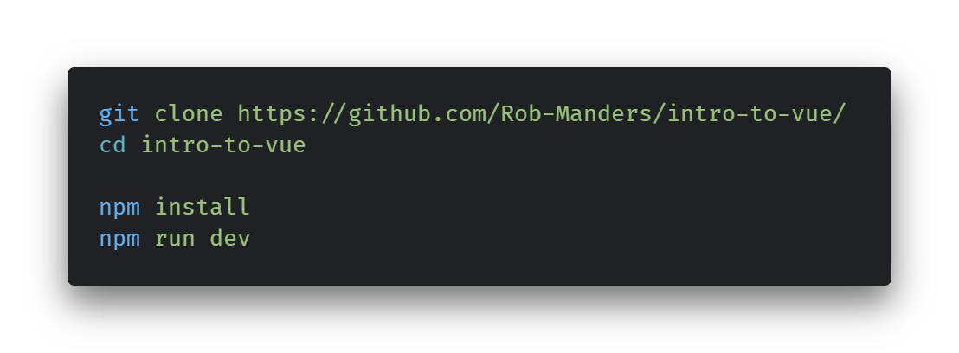
Introduction to vue
Robert Manders
21st February 2024
Notes:
Visit the URL to fork the repository into your own repo if you wish.

Slide 2
Vue JS
A declarative, component based Javascript framework for building front end web applications.
Uses standard HTML, CSS and Javascript
Capable of using SASS/SCSS and Typescript
Wide ecosystem of products to provide additional functionality, such as client-side routing (Vue Router) and state management (Pinia)
Reactive state
Clean, concise single file components
Excellent documentation
vuejs.org/guide
Notes:
Declarative: Declaring what needs to be done rather than how to do it.

Slide 3
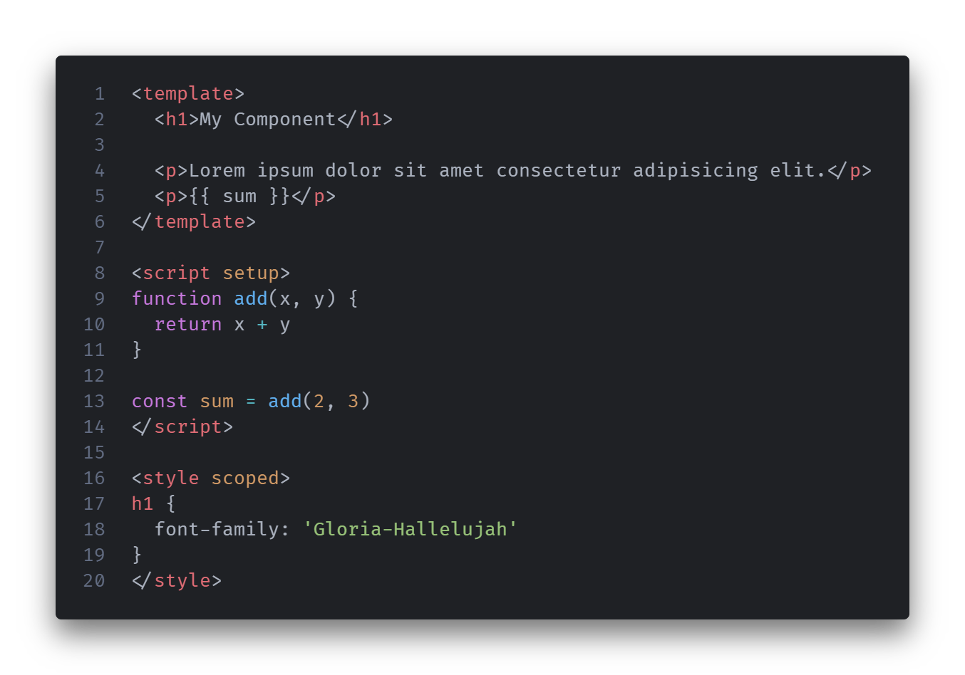

Slide 4
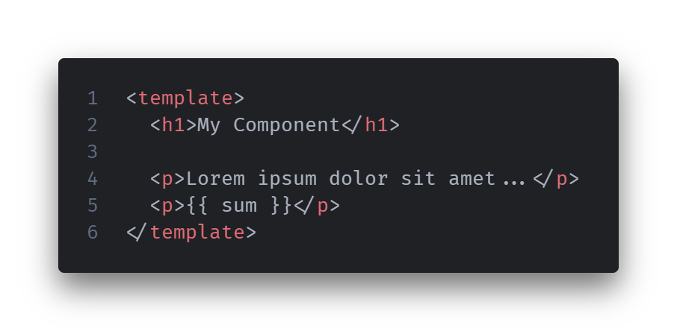
template
Uses HTML-like markup to layout the DOM elements.
Use classes and IDs for styling.
Allows variables and state to be referenced in or bound to elements.
Will automatically update the DOM when state changes.
Provides event handlers on elements.

Slide 5
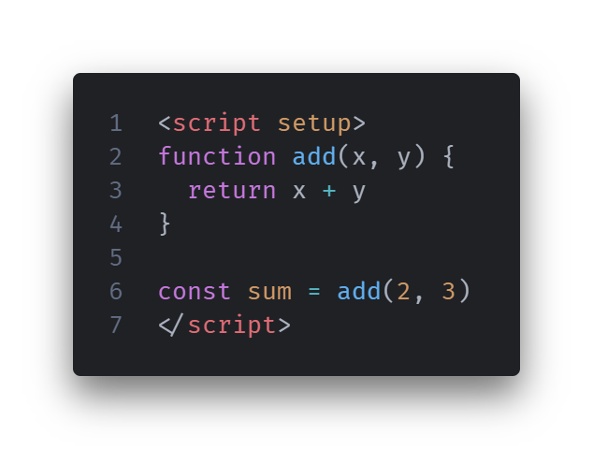
Script
Uses the Options or Composition API.
We will be using the Composition API.
A space to write your Javascript functionality for the component.
Declare variables, state and functions.
Import external modules, hooks and components.
Supports Typescript.
Requires Typescript as a dependency.
Can be set up when you create the project.
Notes:
Options API returns a setup function containing state and functionality.
Composition API allows for Javascript (or Typescript) to be written in a more normal manner.

Slide 6
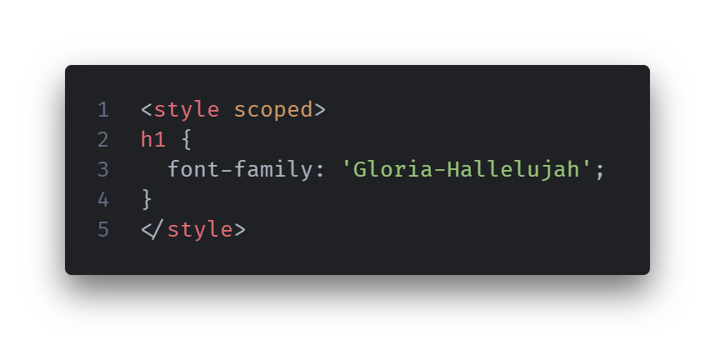
style
CSS styling for your DOM elements.
Globally available by default.
Scoped attribute ensures styles only affect this component.
CSS selectors behave as usual.
State can be passed into the style.
Can support SASS/SCSS.
Requires Sass as a Node dependency.
Notes:
Typically recommend using scopes styles.
In this project, the global styles have been included as CSS files in the assets which are loaded into main.js.

Slide 7
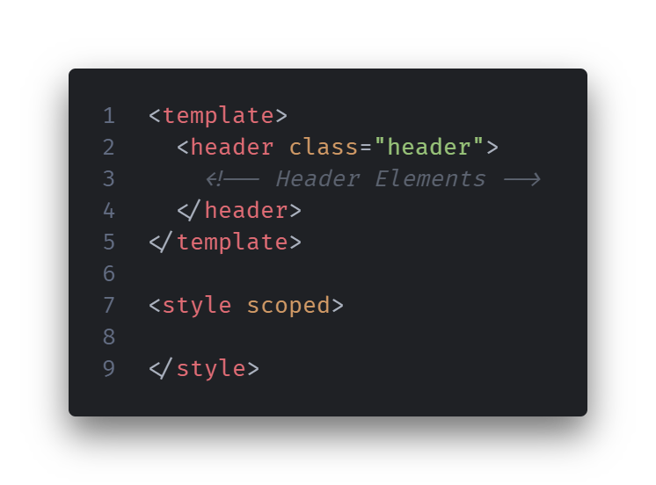
Build a header component
Header.vue
Add some HTML elements to the template.
Add some styles.
Some example styles are provided, but you don’t have to use these if you don’t want to.

Slide 8
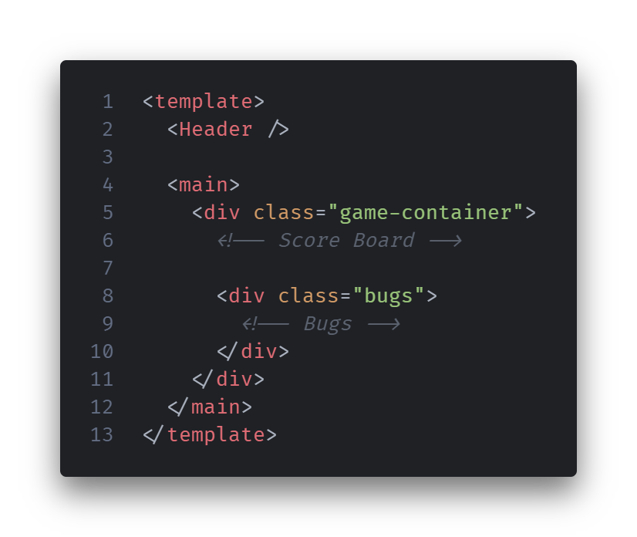
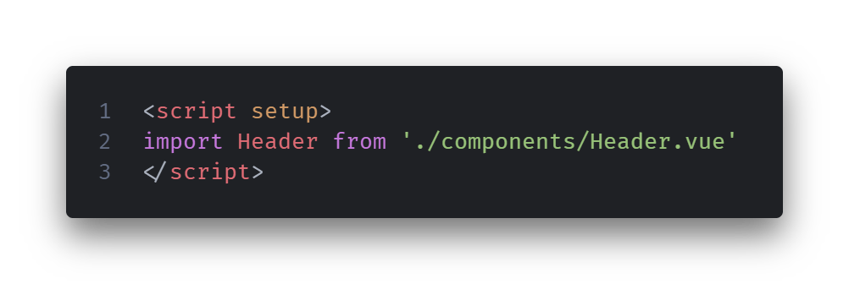
Add the header component to your app
App.vue
Import the header element within your script.
Add the Header element to the template.
Refresh your browser to see the changes.

Slide 9
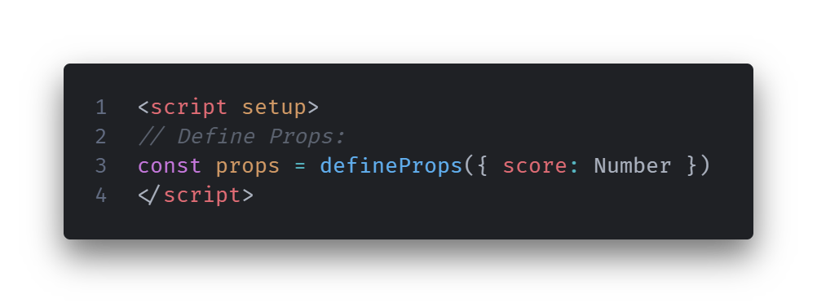
props
Allow us to pass variables or state directly into a component.
Define a ‘score’ prop in our score board component.
Props must be defined on the component we want to pass the props into.
In Javascript, props can be defined as an array of strings or an object of { prop: type }.

Slide 10
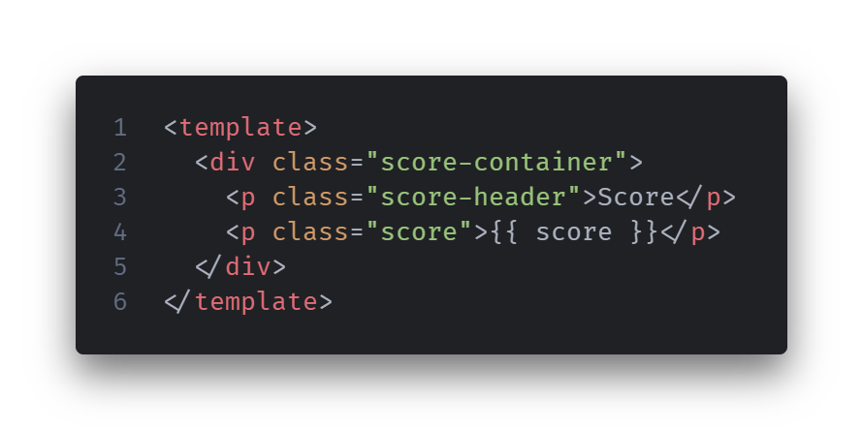
props
Props can be used directly in our template using the {{ prop }} syntax or bound to elements.
This will reference the prop and display its value when rendered to our page.
Add the score board elements to the template and consume the score prop.

Slide 11
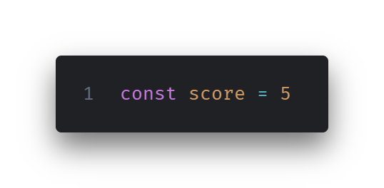
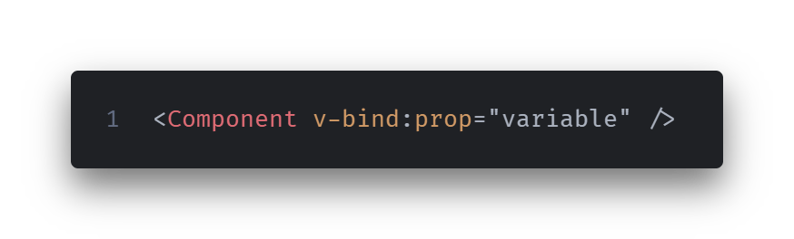
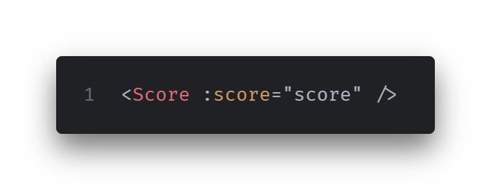
V-bind:
Create a variable to hold our score state.
Import and add the score component to App.vue.
Use the shorthand : to bind the score variable to our score prop.
v-bind: allows us to bind a variable or piece of state to a component or element.
Allows us to bind to props, or other attributes such as an element’s class.
The shorthand for v-bind: is a colon.
:
This will be temporary for now just to see this working.

Slide 12
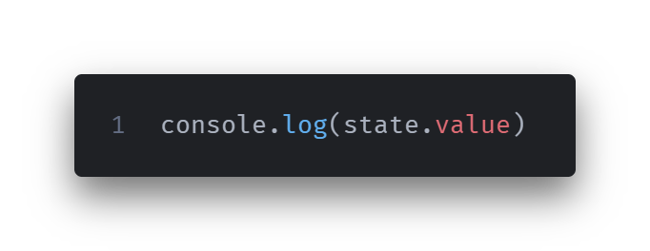
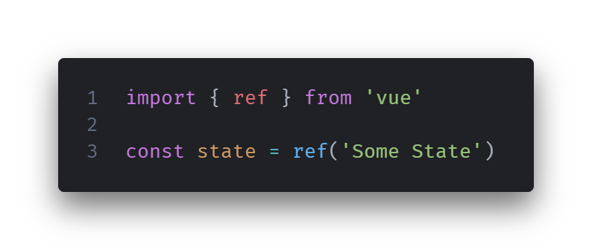
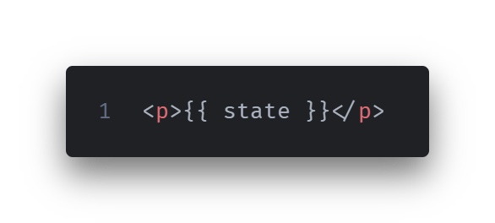
Ref()
Vue has a few ways of managing reactive state.
The simplest and most common is with ref().
We can define a piece of state by passing the value into the ref() method.
The value of a piece of state can be accessed via the value method in our script.
Templates will access the value automatically, so we can pass in our state like any other variable.
Notes:
Returns an object containing a value property.
Computed properties are also a common method. These are pieces of state derived from some logic or calculation, for example, the big image selector in Bug.vue.

Slide 13
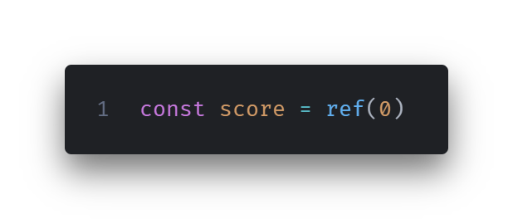
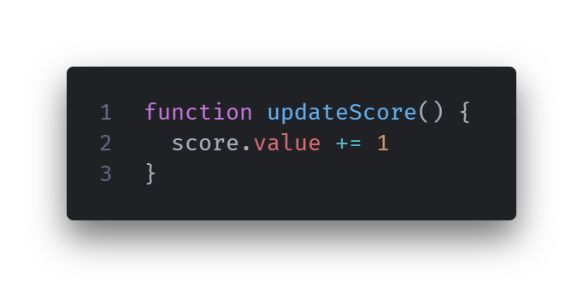
Store and update our score state
Use ref() to store the state for our score.
You can replace the existing score variable with the ref() method.
Create a function to let us update our state.
Remember, we need to access the value property to read and update the ref in our script.
We will use the function shortly to update our score.

Slide 14
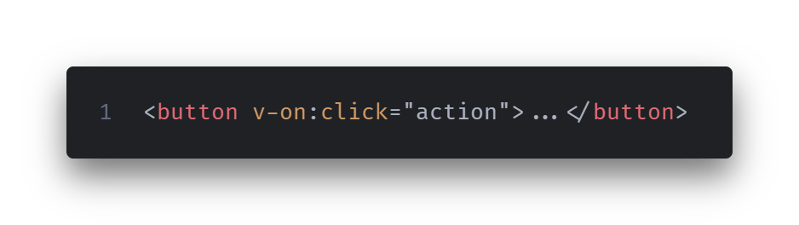
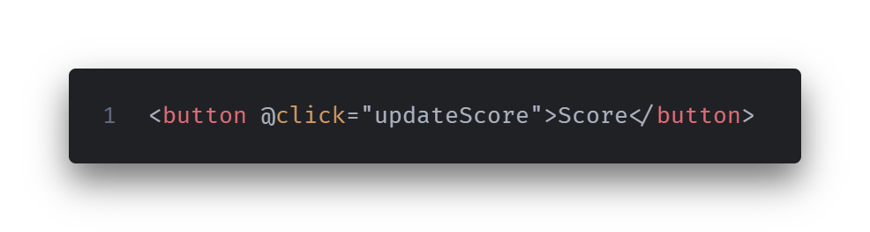
Event handlers
Vue uses v-on: to handle events, such as click events, on elements in your template.
The shorthand for v-on: is @.
Use the shorthand to create a button and pass in our updateScore() function as the action.
If you click the button you should see the score increase.
Notes:
You will pretty much never see v-on written in Vue applications, the @ shorthand is used almost exclusively.

Slide 15
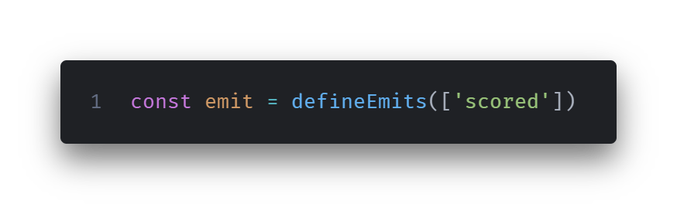
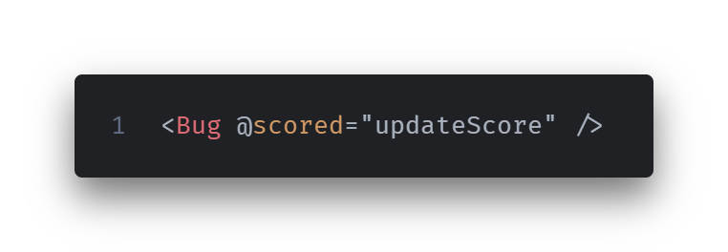
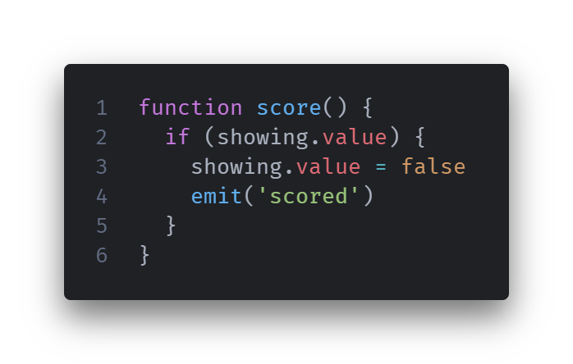
Emit custom events
Define a ‘scored’ event emitter in Bug.vue.
Write a function to emit the event when we score.
Use a click handler on our bug-container div to trigger the score() function.
In App.vue, import the Bug component and add some bugs to the template.
Use the scored event to trigger the updateScore() function.
Don’t forget to delete the button we created previously.
Notes:
There are several ways to define emitters in defineEmits. The list here is the simplest, but you may want to use other options if you need to determine the variable type, e.g., if you’re using Typescript.

Slide 16
challenges
Use v-for: to render multiple Bug components
Use v-if: to set up a start button
v-for: can also be used to iterate over lists, for example, a list of articles on a blog.
It can also be used to render several items depending on a variable.
Currently, we just have several Bug components in our template.
We can tidy this up by using v-for: to render the number of bugs we need depending on a variable.
Create a variable for the number of bugs you want, then use v-for: to render them.
v-if: allows us to conditionally render a component or element based on a condition.
Currently, our game starts immediately when the page loads.
Create a start button component and some state to track if the game has been started.
Use v-if: to only show the game container if the start button has been clicked.
Notes:
The Vue documentation provides good examples on how to use v-for: and v-if:.

